Slide 1
Topic: Geometry
EQ: What are the different terms used to describe solid shapes?
It may seem very basic, but if you don’t know the terminology, you have no hope in understanding the questions.
Engage with the lesson by listening and answering questions. DON’T TALK TO YOUR NEIGBOUR ABOUT RANDOM THINGS
Write the notes down on the last slide ONLY
EST content

Slide 2
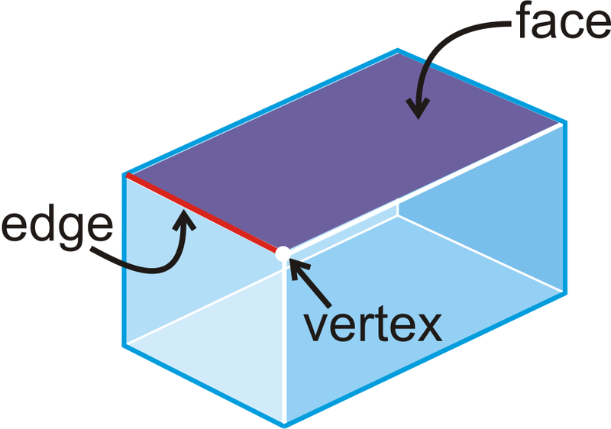
3D shapes Face, edges and vertices
A face is the flat surface of a solid figure.
An edge is formed when two faces meet. An edge is a straight line segment.
A vertex is a point where edges meet

Slide 3
Faces, Edges and Vertices
Three dimensional (3D) shapes are defined by the number of faces, edges and vertices (corners) that they have.
VERTEX (plural is vertices)
EDGE
FACE
TETRAHEDRON

Slide 4
Faces, Edges and Vertices
Three dimensional (3D) shapes are defined by the number of faces, edges and vertices (corners) that they have.
Faces
4
A tetrahedron is a pyramid with triangular faces.
Edges
6
Vertices
4
A tetrahedron is the simplest of all the 3D shapes.
TETRAHEDRON

Slide 5
Faces, Edges and Vertices
A square based pyramid has:
Faces
5
Edges
8
Vertices
5
A square based pyramid

Slide 6
Find the number of faces, edges and vertices for each of the 3D shapes shown below.
1
Faces
6
2
Faces
7
Edges
10
Edges
15
Vertices
6
Vertices
10
Pentagonal based pyramid
Pentagonal based prism
3
Faces
6
Edges
12
Vertices
8
Cuboid

Slide 7
Find the number of faces, edges and vertices for each of the 3D shapes shown below.
4
5
Faces
7
Faces
6
Edges
12
Edges
12
Vertices
8
Vertices
7
Cube
Hexagonal based pyramid
6
Faces
8
Edges
18
Vertices
12
Hexagonal based prism

Slide 8
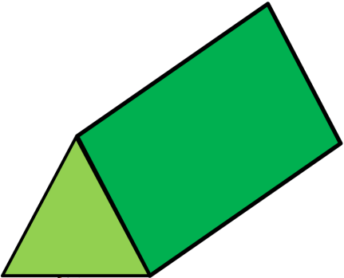
I am a Prism
I have two identical faces.
All my other faces are quadrilateral
(Rectangle or square)
Notes:
Presentation to be given, demonstrating with 3D shape in teacher’s hand. Pupils are allowed to bring 1 shape from their box – as teacher goes through presentation slides, ask pupils to hold hands up if they have a prism / non prism in their hands – this puts them into teams for the disappearing shape game.

Slide 9
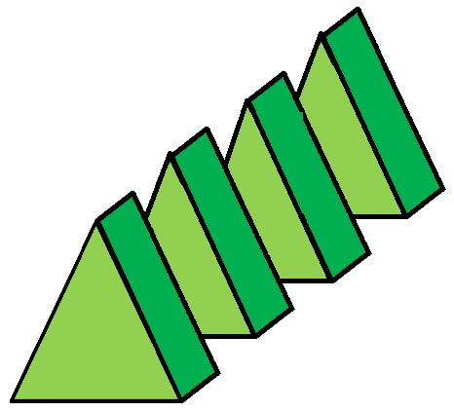
I am a Prism
When sliced parallel to the face, the cut edges of a prism are identical to the faces at either end.

Slide 10
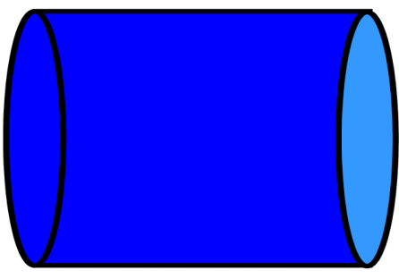
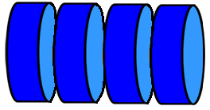
I am a Prism
When sliced parallel to the face, the cut edges of a prism are identical to the faces at either end.

Slide 11

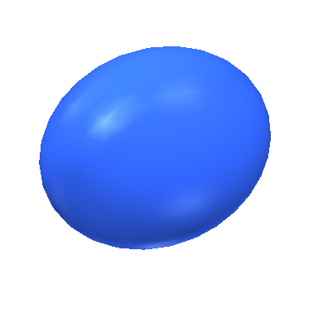
I am not a Prism
When sliced parallel to the face, the cut edges of a prism are identical to the faces at either end – this shapes slices are not identical

Slide 12
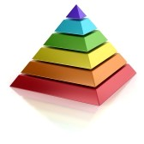
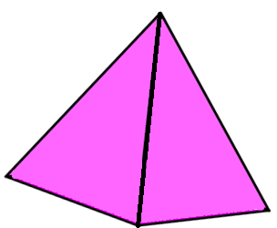
I am not a Prism
When sliced Parallel to the face, the cut edges of a prism are identical to the faces at either end – this shapes slices are not identical

Slide 13
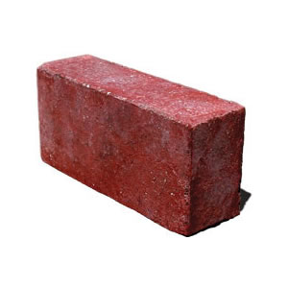
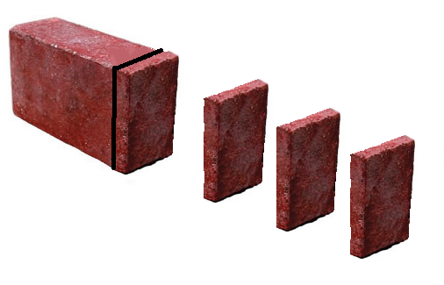
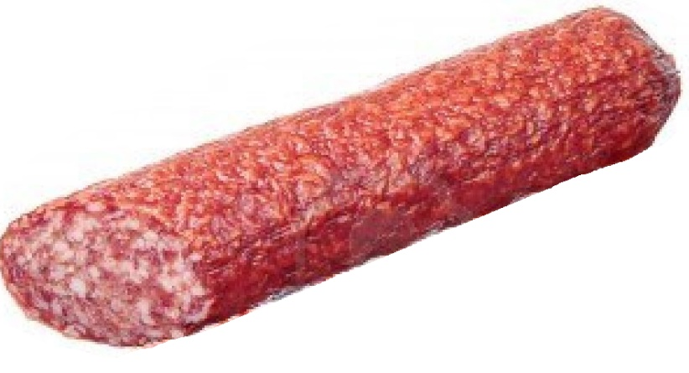

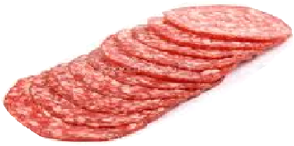
Prism?

Slide 14
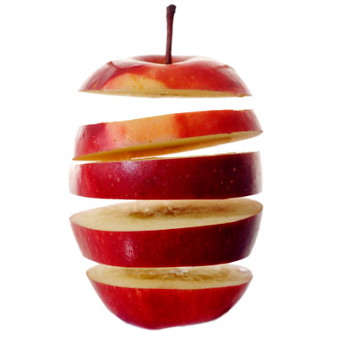
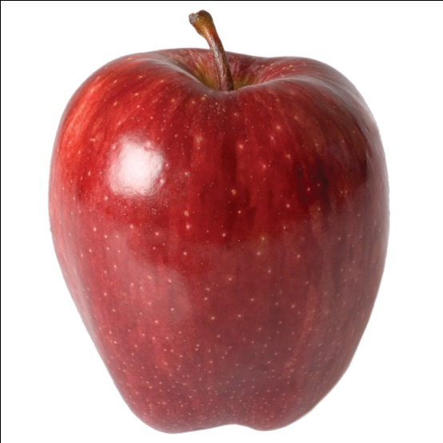
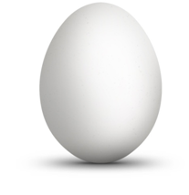
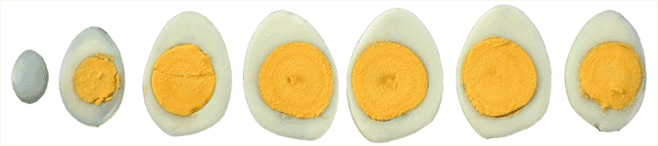
Prism?

Slide 15
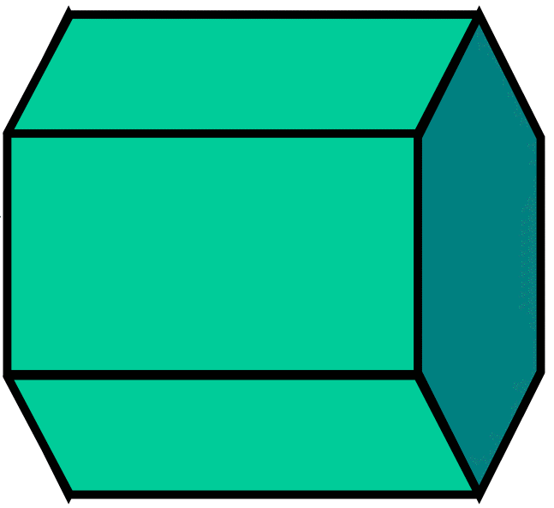
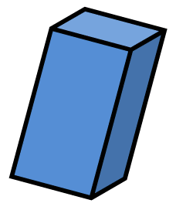
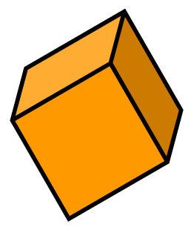
Prisms

Slide 16
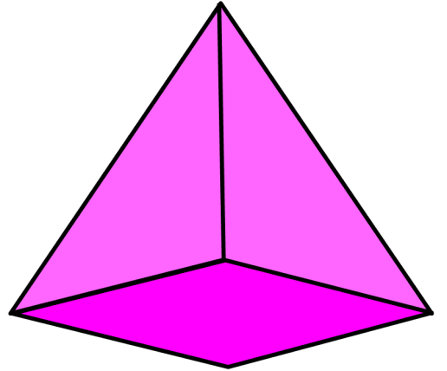
I am a Pyramid
I have one base (also called a face).
All my other faces slope and meet at one vertex.
I am a Non-Prism

Slide 17
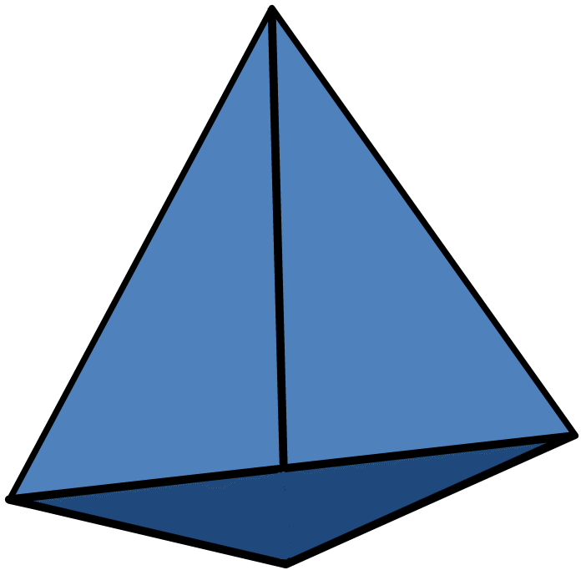
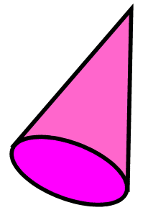
Pyramids
Non-Prisms

Slide 18
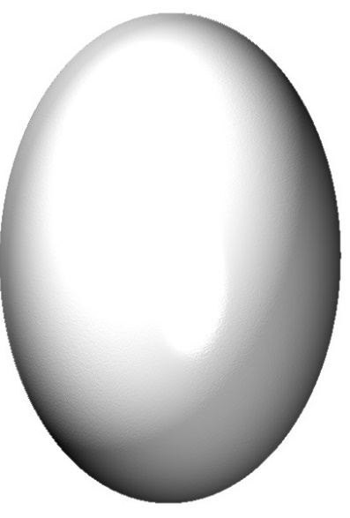
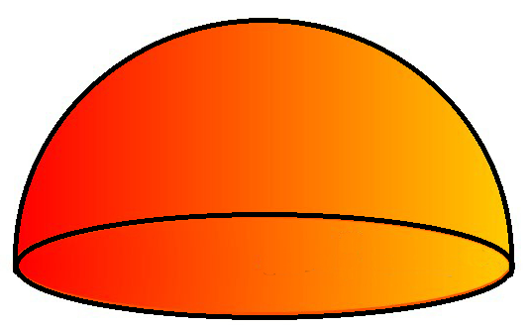
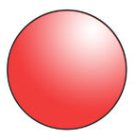
Other Non-Prisms

Slide 19
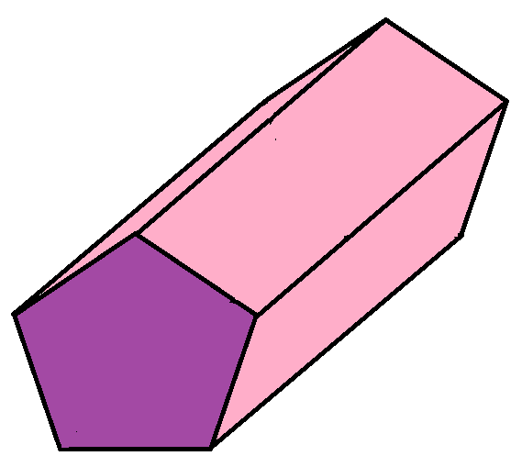
Prisms
Cylinder
Cuboid
Cube
Hexagon-based
prism
Triangle-based
prism
Pentagon-based
prism

Slide 20

Pyramids & Non-Prisms
Cone
Triangle-based Pyramid
Square-based Pyramid
Sphere
Hemisphere
Ellipsoid

Slide 21





3D Shapes
Prisms
Pentagon-based
prism
Cylinder
Cuboid
Hexagon-based
prism
Triangle-based
prism
Cube
Triangle-based Pyramid
Square-based Pyramid
Sphere
Hemisphere
Cone
Ellipsoid

Slide 22
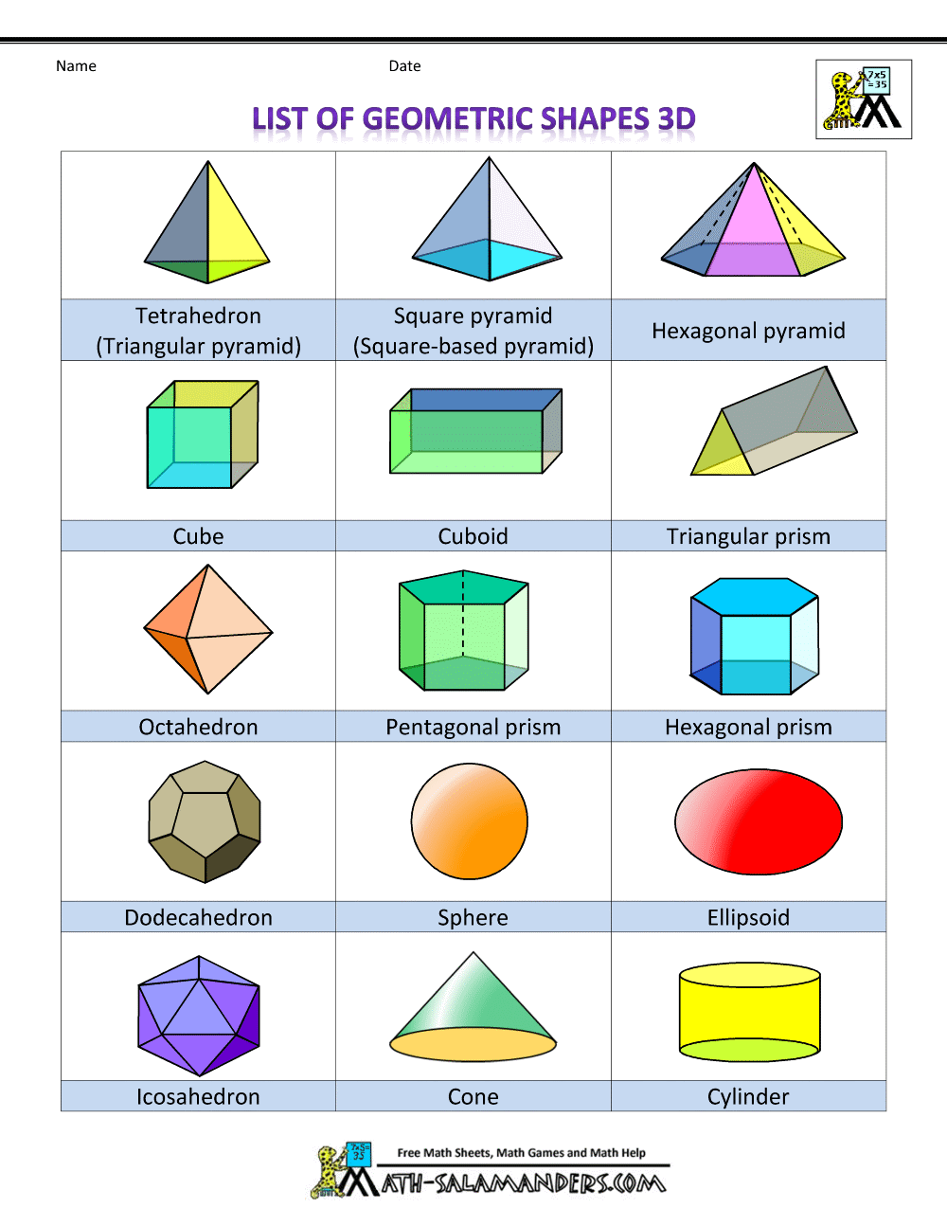
Naming pyramids.
Pyramids are named according to the shape of their base
Could also be called a circle based pyramid
Naming Prisms .
Prisms are named according to shape on the end
Could also be called a rectangular prism

Slide 23
Geometry
EQ – What are the different terms used to describe solid shapes?
A face is the flat surface of a solid figure.
An edge is formed when two faces meet.
A vertex is a point where edges meet
A Prism is a shape with identical ends separated by rectangles or square. When sliced in the middle the cut edge is identical to the ends.
Prisms are named according to shape on the end
Pyramids have one face as a base and all other faces meet at a single vertex
Pyramids are named according to the shape of their base
Complete chapter 13 Of MAWA Essentials Units 3 and 4, page 48.

Slide 24
Geometry
EQ – What are the different terms used to describe solid shapes?
Complete chapter 13 Of MAWA Essentials Units 3 and 4, page 48.

